Slide 1
NEWSPAPER MANAGEMENT DATABASE SYSTEM Course Title: Database System Laboratory Course Code: CSE 3210
Submitted To:
Md. Badiuzzaman Shuvo
Lecturer
Department of Computer Science Engineering
Nawaz Talukder Sanglap
Lecturer
Department of Electronics and Communication Engineering
Submitted By:
Tawsif Kaisar
Roll no: 1909053
Year: 3rd
Semester: 2nd
Session: 2021-2022
Department of Electronics and Communication Engineering

Slide 2
Introduction
The newspaper management system is a database-driven application that aims to develop a comprehensive database system to streamline and enhance the management of a newspaper company's operations. This system will facilitate efficient content management, subscriber and their feedback management and distribution processes. A well-designed newspaper management system can help newspapers to be more efficient and productive, and to improve the quality of their content. By implementing this database, the newspaper company can improve its operational efficiency, customer service, and overall competitiveness in the media industry.

Slide 3
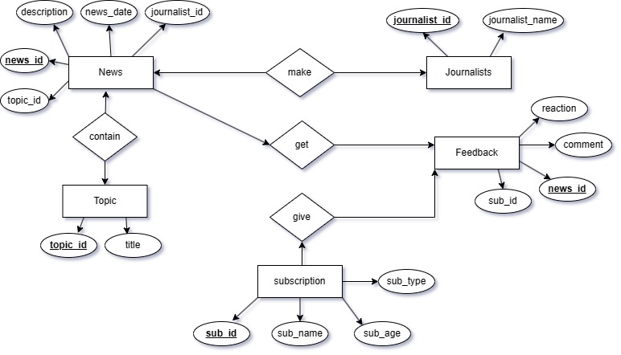
E-R Diagram

Slide 4
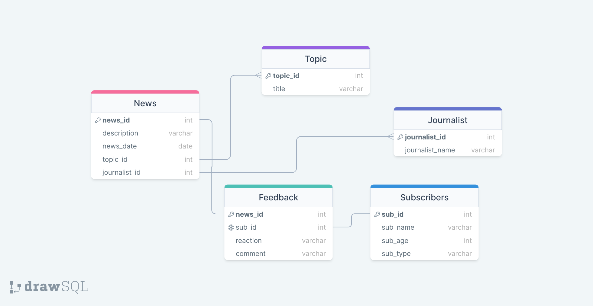
Schema Diagram

Slide 5
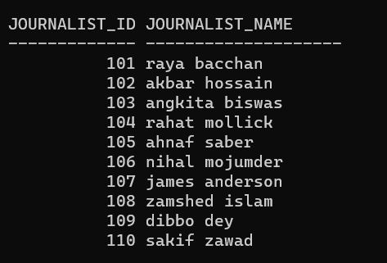
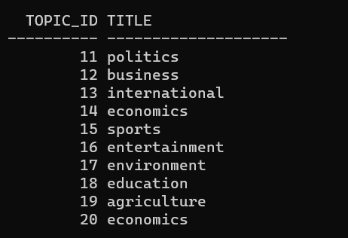
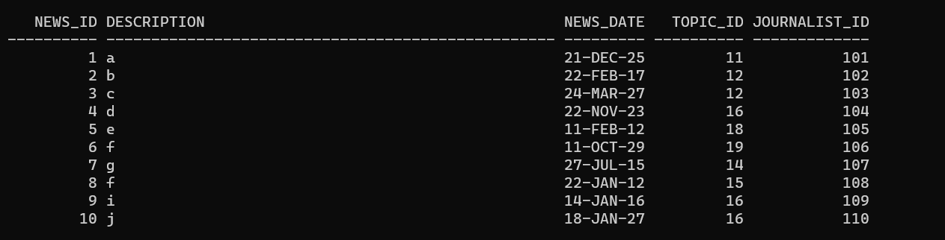
Tables
Journalist
Topic
News

Slide 6
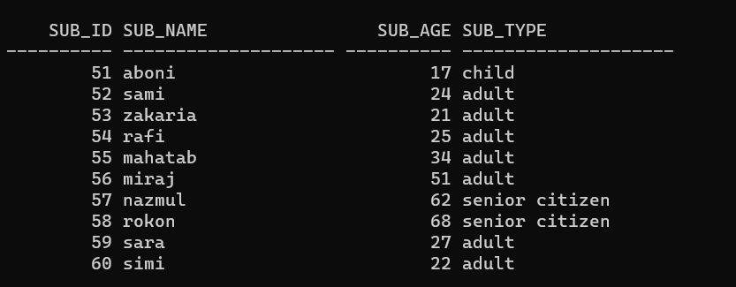
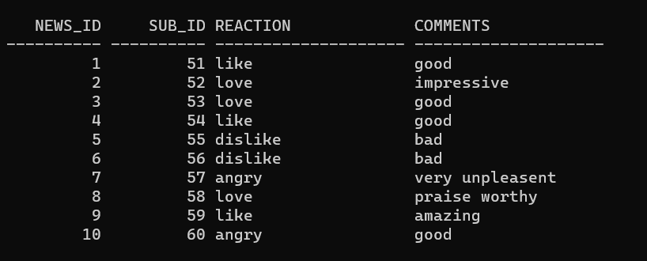
Tables
Subscribers
Feedback

Slide 7
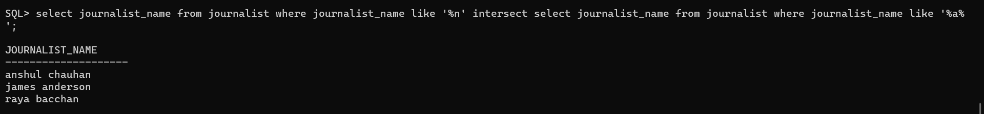
Some Queries
SHOWING TOPIC TITLE OF A JOURNALIST
SHOWING THE NAME OF THE JOURNALISTS WHOSE NAME ENDS WITH 'N' AND HAS 'A' IN THE NAME
TOTAL UNIQUE(NAME) JOURNALISTS IN NAME

Slide 8
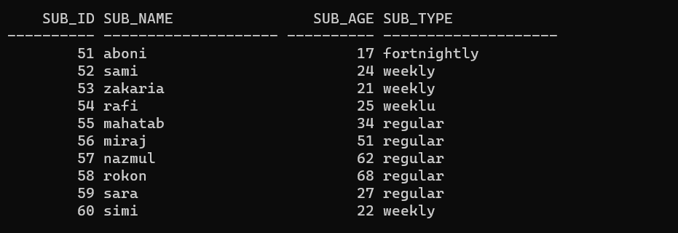
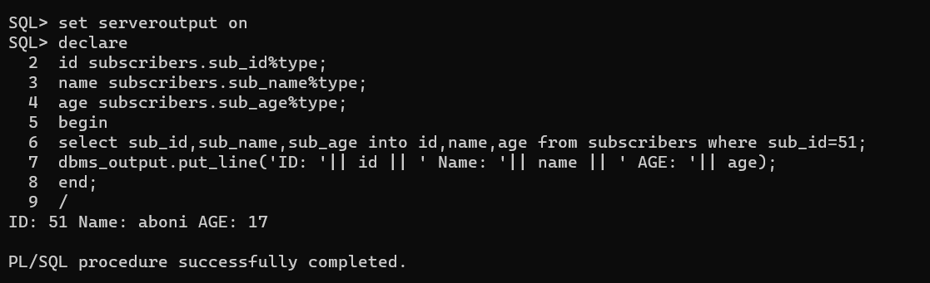
PL/SQL
Subscribers Table
Query using PL/SQL

Slide 9
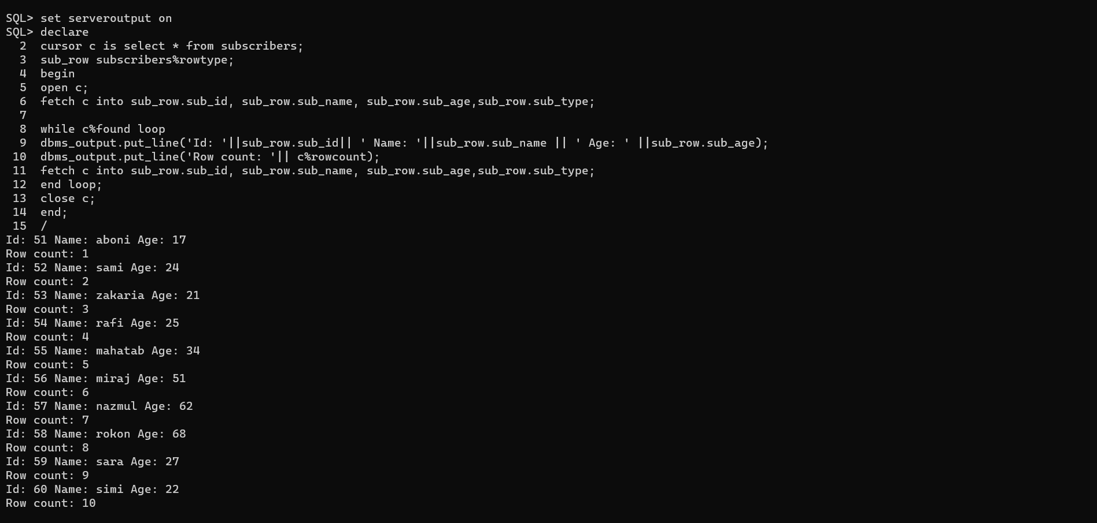
Cursor
Using cursor and finding the total number of rows

Slide 10
Thank You!!

